Slide 1

Basic Details of the Team and Problem Statement
Ministry/ Organization Name: All India Council for Technical Education(AICTE).
Problem Statement : Graphical Password Authentication
Team Name: PIXEL PERFECT
Team Leader Name : SUJITHA.P
Institute Code : 4211
Institute Name : IFET COLLEGE OF ENGINEERING

Slide 2
Idea/Approach Details
Problem statement: GRAPHICAL PASSWORD AUTHENTICATION
Almost everyone of us faced an issue like Shoulder Surfing when we type our credentials. It leads to serious issues like password theft and leads to hacked user accounts . So, prevent these type of Shoulder surfing attacks taking place we have to implement a new type of authenticating system.
Like using a graphical password authentication system where instead of creating a password a user has to select graphical objects in a particular order to keep it as their password.
This will allow the user to set passwords in the form of graphical presentation in a certain pattern and later use that pattern to login into the system.

Slide 3
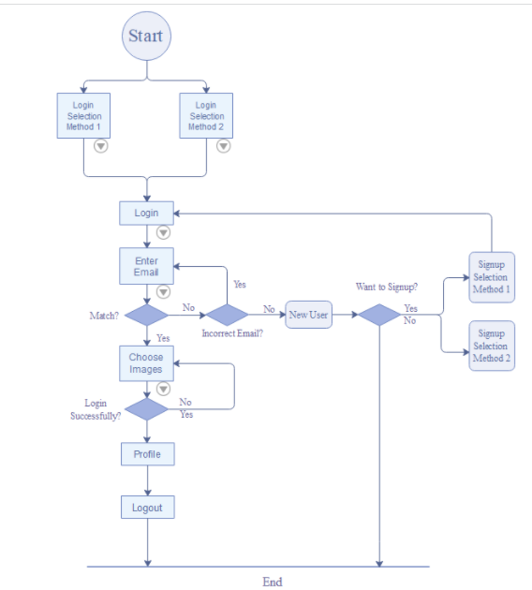
Idea/Approach Details
Idea for the Problem:
Method 1- The user is required to select some images in a specific pattern. Next time the user tries to log in, the images would have been shuffled, but the user will be required to follow the same pattern which was used initially. Every time the user will have to use the same sequence while the images are placed in different ways.
The user is asked to select one image from row and another image from the column in the registration process. Later, a number of images will be displayed along with registration page images .The intersection image of the preselected image should be considered as a password.
Platform /Technology used:
Python , HTML

Slide 4
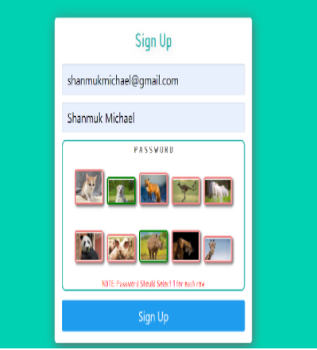
Idea/Approach Details
Benefits:
Graphical passwords are an alternative to alphanumeric passwords.
It satisfies both conflicting requirements i.e. easy to remember and hard to guess.By the problem of shoulder surfing problem, it becomes more secure and easier password scheme.
This type of authentication is difficult to break since neither brute force nor dictionary attacks could breach it.
We need this techniques that can be easily implemented and provide better results to this process.

Slide 5
THANK YOU

